Slide 1



A-Eye: See beyond limitations

Slide 2

Team Members
Abdelaziz Salah
Abdelrahman Noaman
Khaled Hesham
Kirollos Samy
Supervised By : Dr. Yousef Ghatas

Slide 3




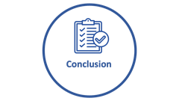


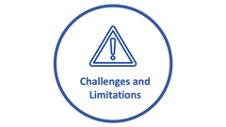

Agenda

Slide 4

Motivation

Slide 5

Motivation
“ Empowering the visually impaired people to seamlessly navigate and perceive the world around them. ”

Slide 6

Motivation
Navigating the world around you is an essential endeavor

Slide 7

Motivation
Navigating the world around you is an essential endeavor
Obstacles pose potential harm to blind individuals, impeding their safe navigation in various environments.

Slide 8

Motivation
Navigating the world around you is an essential endeavor
Obstacles pose potential harm to blind individuals, impeding their safe navigation in various environments.
Understanding the environment surrounding is a big matter that hardens lives of blind people

Slide 9

Motivation
Navigating the world around you is an essential endeavor
Obstacles pose potential harm to blind individuals, impeding their safe navigation in various environments.
Understanding the environment surrounding is a big matter that hardens lives of blind people
Being blind can make individuals vulnerable to deception by others who may take advantage of their visual impairment.

Slide 10

Market and Literature Survey

Slide 11


Market Survey
providing advanced indoor positioning and navigation solutions.
integrated with iBeacons, leveraging this technology to enhance indoor positioning accuracy
It provides only navigation using a hardware devices
Cons: Expensive - needs pre-setup - limited to navigation
Notes:
https://duotone.shapefactory.co/?i=-HH3cGeAC4o&f=3fc7ff&t=2c0058&q=_
https://duotone.shapefactory.co/?f=3fc7ff&t=2c0058&q=_

Slide 12

Market Survey
provides a range of location-based services, including navigation, asset tracking, and analytics
integrated with I Beacons, and uses Bluetooth low energy (BLE) and Wi-Fi signals to create unique fingerprints for different location
Cons: Expensive - needs pre-setup – limited to navigation only
Notes:
https://duotone.shapefactory.co/?i=-HH3cGeAC4o&f=3fc7ff&t=2c0058&q=_
https://duotone.shapefactory.co/?f=3fc7ff&t=2c0058&q=_

Slide 13

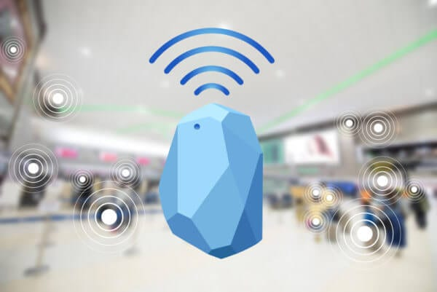
I Beacons
Protocol developed by Apple
Applied on hardware transmitter called beacons
They are BLE electronic devices.
They repeatedly broadcast their identifier to nearby portable electronic devices
Average price = 25$

Slide 14

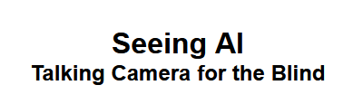
Market Survey
Provides a range of vision assistance tasks.
Describe the scene
speak text as it appears in front of the camera
Currency Identification
Cons:
No voice accessibility commands
No navigation features
Notes:
https://duotone.shapefactory.co/?i=-HH3cGeAC4o&f=3fc7ff&t=2c0058&q=_
https://duotone.shapefactory.co/?f=3fc7ff&t=2c0058&q=_

Slide 15

Features

Slide 16
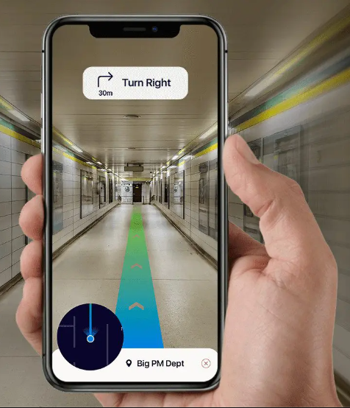
Features
indoor navigation system designed to empower individuals with visual impairments

Slide 17

Features
indoor navigation system designed to empower individuals with visual impairments
Obstacle Avoidance

Slide 18


Features
indoor navigation system designed to empower individuals with visual impairments
There are … … … in front of you!
Obstacle Avoidance
Scene Description

Slide 19

Features
indoor navigation system designed to empower individuals with visual impairments
Obstacle Avoidance
Scene Description
Reading Text

Slide 20
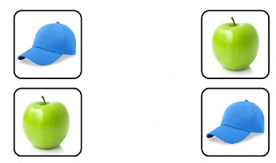
Features
indoor navigation system designed to empower individuals with visual impairments
Obstacle Avoidance
Scene Description
Object Matching

Slide 21
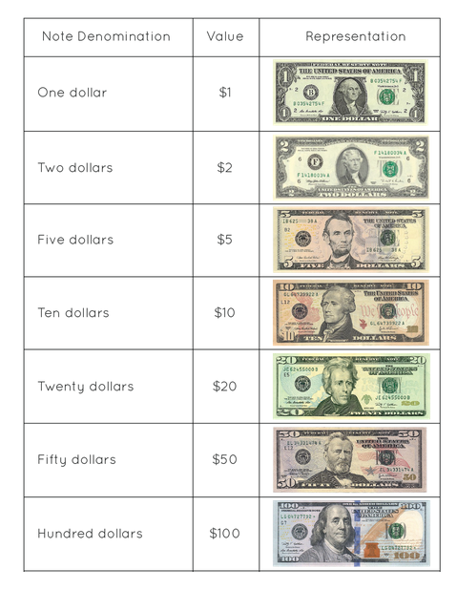
Features
indoor navigation system designed to empower individuals with visual impairments
Obstacle Avoidance
Scene Description
Reading Text
Object Matching
Identifying Currency

Slide 23

Application Accessibility
The User can use our application in two main ways:
Voice Commands

Slide 24

Application Accessibility
The User can use our application in two main ways:
Voice Commands
GUI with Voice over assistance

Slide 25
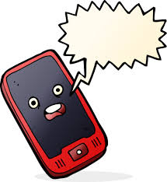
Application Accessibility
The System response will be voice.
Take care. go left.
This is the world!

Slide 26

System Architecture

Slide 27
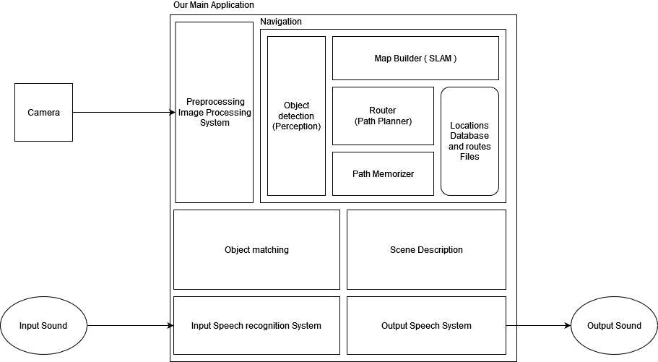
System Architecture

Slide 28

System Modules

Slide 29
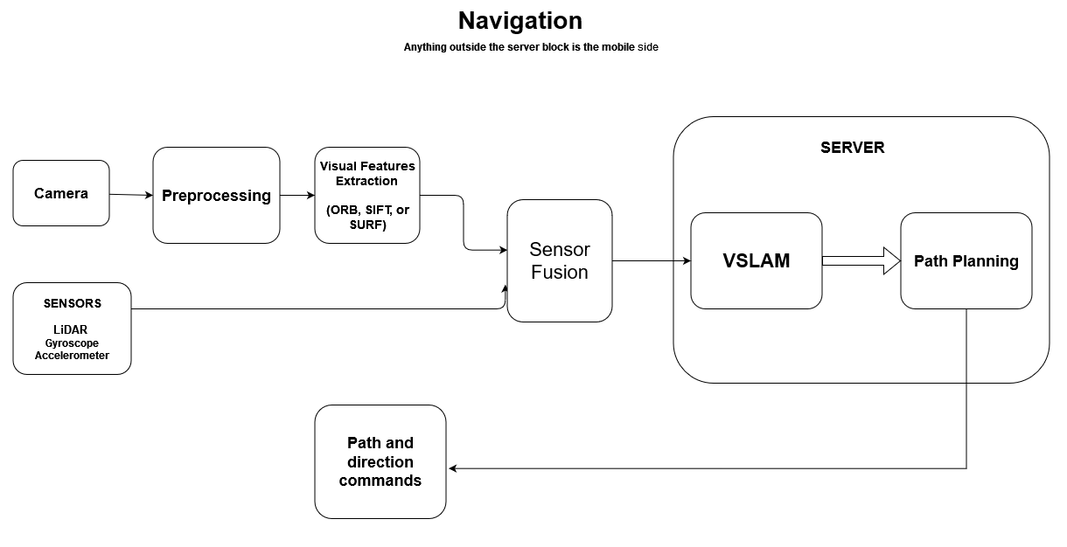
Navigation Module

Slide 30
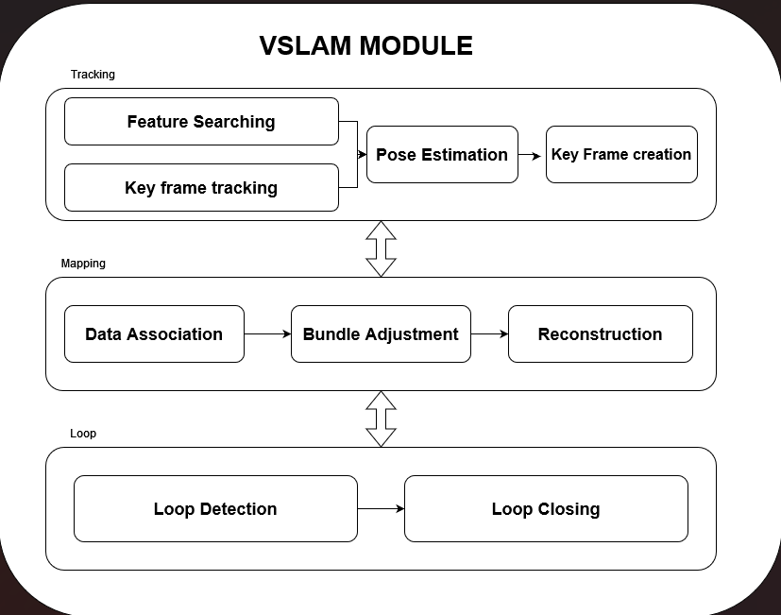
VSLAM Module

Slide 31
Object Matching Module
TODO

Slide 32
Scene Description module
TODO

Slide 33
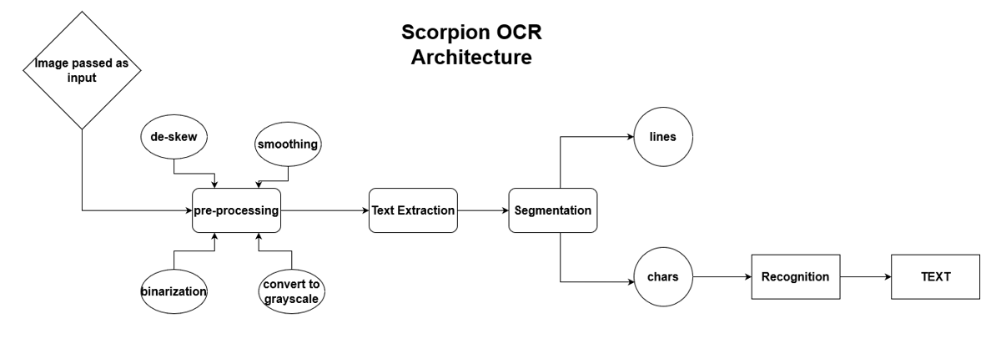
Optical Character Recognition(OCR)
OCR
Architecture

Slide 34

Challenges and
Limitations

Slide 35

Challenges
Person safety
Localization
Mapping
Object matching.
Scene Description
Accuracy and real-time response

Slide 36

Limitations
Server Response and Internet connection
Phone Type
Relying only on the phone’s camera without any support of any external sensors.
To apply the navigation, somebody must apply some landmarks for at least one time, then capture them to the blind person.

Slide 37

Conclusion

Slide 38
Conclusion
Our tool assists the visually impaired people to easily
Navigate
Match Objects
Describe the scene
Allow them to give voice commands

Slide 39

Future Work

Slide 40

Future Work
Apply outdoor navigation.
Add more vision features such as OCR and Currency identification.
Try to get better accuracy with relying on more external sensors
Performance optimization to decrease runtime.
Add more integrations.

Slide 41
Project Modules
Module | Abdelrahman Noaman | Abdelaziz Salah | Khaled Hesham | Kirollos Samy | Ready-made %
VSLAM
Object Matching
Scene Description |  |  |  |  | 80%
OCR
Mobile Application

